Slide 1
DEPARTMENT OF MATHEMATICS & SCIENCE GOVERNMENT POLYTECHNIC BARGARH
COMPUTER APPLICATION
CHAPTER 1
Prepared by: Dr. Anitarani brahma
Mrs banani mohanty

Slide 2
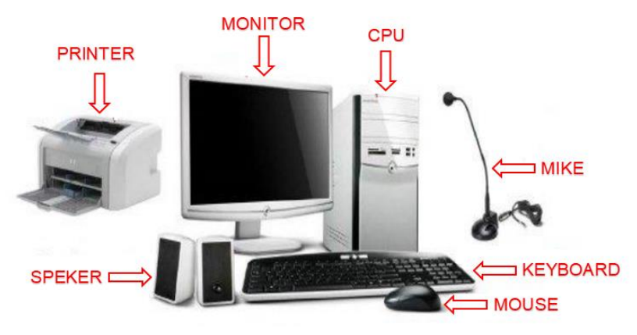
INTRODUCTION TO COMPUTER
Computer is an electronic device that operates (works) under the control of programs stored in its own memory unit. •
A computer is an electronic machine that processes raw data to give information as output. •
An electronic device that accepts data as input, and transforms it under the influence of a set of special instructions called Programs, to produce the desired output (referred to as Information).

Slide 3
EVOLUTION OF COMPUTER
Note: In the current academic session 2023-24, in the first round of allotment, the girl’s enrolment is 46.55% (Out of 116, girl’s enrolment is 54)
Computer evolution refers to the change in computer technology right from the time computers were first used to the present.
As computing evolves to higher system levels, so its design also changes, from technical to socio-technical design.
The series of the evolution of computers are given below.
✓ Abacus
✓ Pascaline
✓ Difference engine
✓ Punched card equipment
✓ ABC
✓ UNIVAC -

Slide 4
EVOLUTION OF COMPUTER
Abacus
• The present day computers are a result of an evolutionary process which started way back in 500 B.C. when Egyptian used a machine which is an early form of Abacus.
• However the present form of Abacus is attributed to the Chinese and Japanese.
• This is a machine, which was used for addition, subtraction, multiplication and division operation.
Pascaline
• In 1645 a device known as Pascaline was invented by French mathematician Blaise Pascal.
• The machine was also used per addition and subtraction purpose.
• The device was operated by dialing a set of wheels.
• In 1671 Leibniz improved on Pascal's adding machine and invented the Leibniz's Calculator.
Difference engine
• In 1822 Charles Babbage invented a Difference Engine.
• The purpose of this device was to calculate the roots of polynomial equations and prepare astronomy table for the British Navy.
• He upgraded this to, invent an Analytical engine, which could store program instructions initially coded on punched cards and subsequently shared internally.
• Therefore Charles Babbage is known as the father of computers. Punched card equipment
• In 1890 Dr. H. Hollerith developed punched card equipment.
• This equipment read the holes punched in the card and mechanically performed the statistical analysis.

Slide 5
EVOLUTION OF COMPUTER
ABC (Atanasoff-Berry Computer )
• The first pure electronic computer was invented by J. V. Atanasoff and C. Berry which is known as Atanasoff-Berry Computer or ABC.
• It used vacuum tubes for both data storage and data computation.
• Subsequently Electronic Numerical Integrator and Calculator (ENIAC) was designed and accepted as the general purpose computer. UNIVAC
• In 1945 John Von Neumann first gave the idea of sharing the same internal memory for storing both data and instruction, which was subsequently adopted in every computer organization.
• On this principle subsequently Universal Automatic Computer (UNIVAC-1) was invented

Slide 6
GENERATION OF COMPUTER
First Generation – Vacuum Tubes (1940 – 1956)
These ancient computers utilized vacuum tubes as circuitry and magnetic drums for recollection.
As a result they were huge, actually taking up entire rooms and costing resources to run.
These were ineffective materials which produce a huge amount of heat, sucked enormous electricity and subsequently engendered an abundance of heat which caused perpetual breakdowns.
These first generation computers relied on ‗machine language‘ (which is the most fundamental programming language that can be understood by computers).
These computers were limited to solving one problem at a time.
Input was predicated on punched cards and paper tape. Output emerged on print-outs.
The two eminent machines of this era were the UNIVAC and ENIAC machines – the UNIVAC is the first ever commercial computer which was purchased in 1951 by a business named as the US Census Bureau.

Slide 7
GENERATION OF COMPUTER
Second Generation Computer – Transistors (1956 – 1963)
The supersession of vacuum tubes by transistors, visualized the onset of the second generation of computing. Although first invented in 1947, transistors weren‘t used considerably in computers until the cessation of the 1950s.
They were a huge development over the vacuum tube, despite the fact still subjecting computers to destroying different levels of heat. However they were extremely superior to the vacuum tubes, making computers smaller, more expeditious, inexpensive and less burdensome on electricity use.
They still count on punched card for input/printouts. The language emerged from strange binary language to symbolic (‗assembly‘) languages. These meant programmers could discover instructions in words. Meanwhile during the same time high caliber programming languages were being developed (early versions of COBOL and FORTRAN).
Transistor-driven machines were the first computers to store instructions into their recollections, peregrinating from magnetic drum to magnetic core ‗technology‘. The anticipatory versions of these machines were created for the atomic energy industry.

Slide 8
GENERATION OF COMPUTER
Third Generation – Integrated Circuits (1964 – 1971)
By this phase, transistors were now being miniaturized and put on silicon chips. This led to a huge improvement in speed and effectiveness of these machines.
These were the first computers where users interacted utilizing keyboards and monitors who interfaced with an operating system, a consequential leap up from the punch cards and printouts.
This facilitated these machines to run various applications at once utilizing a central program which functioned to monitor memory. As a result of these advances which again made machines more reasonable and more tiny, a brand new group of users emerged during the ‗60s.

Slide 9
GENERATION OF COMPUTER
Fourth Generation – Microprocessors (1972 – 2010)
This innovation can be defined in one word: Intel. The chip-maker accomplished the Intel 4004 chip in 1971, which located all components of computer such as CPU, recollection, input/output controls onto a single chip.
What overcrowded a room in the 1940s now gets fit in the palm of the hand. The Intel chip contained thousands of unified circuits.
Other primary advances during this period have been the Graphical user interface (GUI), the mouse and more of late the startling advances in laptop capability and hand-held contrivances.
Fifth Generation – Artificial Intelligence (2010 Onwards)
Computer devices with artificial potentiality are still in development, but some of these technologies are commencing to emerge and be used such as voice recognition.
AI is an authenticity, made possible by adopting parallel processing and superconductors. Inclining to the future, computers will be thoroughly revolutionized again by quantum computation, molecular and nano technology.
The essence of fifth generation will be utilizing these technologies to ultimately engender machines which can proceed and acknowledge natural language, and have efficiency to determine and organize themselves.

Slide 10
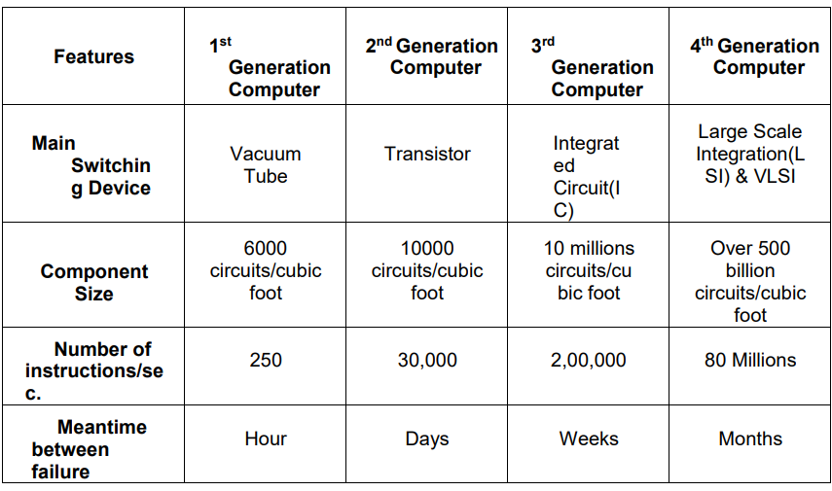

Slide 11
Classification of Computers
All the modern computers are broadly classified into the following three categories.
a) Analog Computer.
b) Digital Computer and
c) Hybrid Computer.
Analog computers
• Are mostly used in industries in process control activities.
• These computers work on analog data such as variation in temperature, pressure, speed, voltage etc.
• They are not general purpose computers; rather they are specific to a particular application area. Therefore the cost of such computer varies from application to application depending on the complexity.
• The uses of such computers are very limited.
Digital computers
• These computers are general purpose computers, which work on digital / binary data.
• The speed and accuracy with which these computers work are very high.
• Digital computers are also having several ranges from super computers to personal computers.

Slide 12
Classification of Computers
Hybrid computers
• Practically Hybrid computer are used to control the entire process.
• The analog feature of such computer enables it to measure the physical quantities such a temperature, pressure, voltage level etc. and convert them to digital data.
• These data are then processed by the computer by using its digital data processing capability.
• The output from this computer may be taken in a paper as hardcopy, may be seen on a display device or may be converted into analog form to automatically control various processes.

Slide 13
Functional Unit of Computer

Slide 14
Functional Unit of Computer
Input Device:
All the input devices perform the following functions.
• Accept the data and instructions from the outside world.
• Convert it to a form that the computer can understand.
• Supply the converted data to the computer system for further processing.
Central Processing Unit:
The Control Unit (CU) and Arithmetic Logic Unit (ALU) of the computer are together known as the Central Processing Unit (CPU).
The CPU is like brain performs the following functions:
• It performs all calculations.
• It takes all decisions.
• It controls all units of the computer.

Slide 15
Functional Unit of Computer
Arithmetic Logical Unit: • All calculations are performed in the Arithmetic Logic Unit (ALU) of the computer. It also does comparison and takes decision. The ALU can perform basic operations such as addition, subtraction, multiplication, division, etc and does logic operations viz, >,<,- etc.
Whenever calculations are required, the control unit transfers the data from storage unit to ALU once the computations are done, the results are transferred to the storage unit by the control unit and then it is send to the output unit for displaying results.
Control Unit: • It controls all other units in the computer. The control unit instructs the input unit, where to store the data after receiving it from the user. It controls the flow of data and instructions from the storage unit to ALU. It also controls the flow of results from the ALU to the storage unit. • The control unit is generally referred as the central nervous system of the computer that control and synchronizes it‘s working.
Output Device: • The output unit of a computer provides the information and results of a computation to outside world. Printers, Visual Display Unit (VDU) are the commonly used output devices. Other commonly used output devices are Speaker, Headphone, and Projector etc.

Slide 16
Functional Unit of Computer
Storage Unit: The storage unit of the computer holds data and instructions that are entered through the input unit, before they are processed.
It preserves the intermediate and final results before these are sent to the output devices. It also saves the data for the later use.
The various storage devices of a computer system are divided into two categories.
a) Primary Storage: Stores and provides very fast. This memory is generally used to hold the program being currently executed in the computer, the data being received from the input unit, the intermediate and final results of the program. The primary memory is temporary in nature. The data is lost, when the computer is switched off. In order to store the data permanently, the data has to be transferred to the secondary memory. The cost of the primary storage is more compared to the secondary storage. Therefore, most computers shave limited primary storage capacit

Slide 17
Functional Unit of Computer
b) Secondary Storage: Secondary storage is used like an archive. It stores several programs, documents, data bases etc. The programs that you run on the computer are first transferred to the primary memory before it is actually run. Whenever the results are saved, again they get stored in the secondary memory. The secondary memory is slower and cheaper than the primary memory. Some of the commonly used secondary memory devices are Hard disk, CD, etc.
Memory Size: • All digital computers use the binary system, i.e. 0‘s and 1‘s. Each character or a number is represented by an 8-bit code. • The set of 8 bits is called a byte. A character occupies 1-byte space. A numeric occupies 2- byte space. Byte is the space occupied in the memory.
• The size of the primary storage is specified in KB (Kilobytes) or MB (Megabyte). One KB is equal to 1024 bytes and one MB is equal to 1000KB. The size of the primary storage in a typical PC usually starts at 16MB. PCs having 32 MB, 48MB, 128 MB, 256MB memory are quite common.

Slide 18
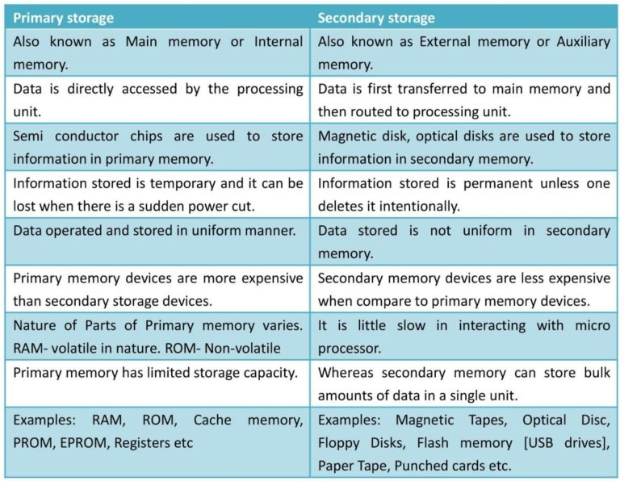
Classification of Memory

Slide 19
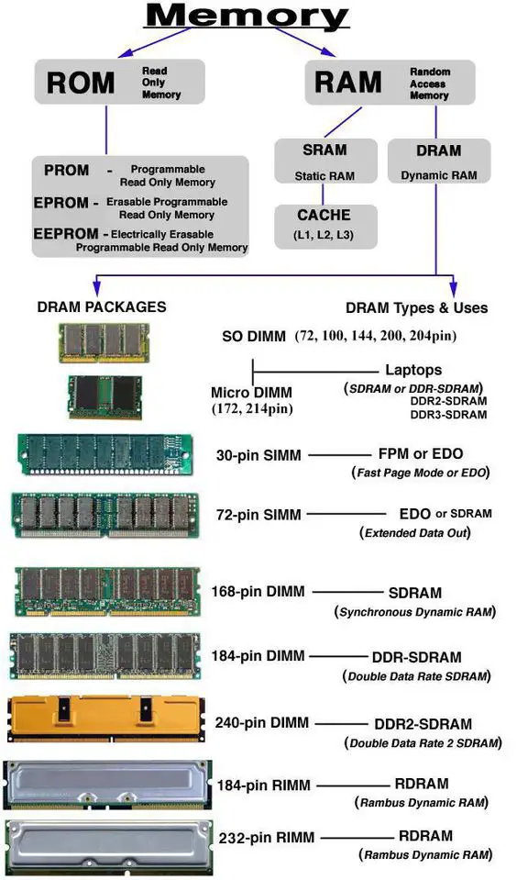
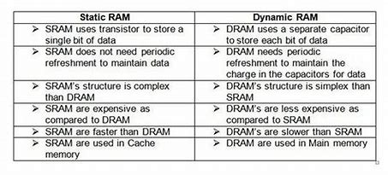

Slide 20
Types of ROM
Types of ROM: ROM is available in several different types, including PROM, EPROM, and EEPROM.
PROM:
PROM stands for Programmable Read-Only Memory, and it is different from true ROM in that while a ROM is programmed (i.e. has data written to it) during the manufacturing process, a PROM is manufactured in an empty state and then programmed later using a PROM programmer or burner.
EPROM: EPROM stands for Erasable Programmable Read-Only Memory, and as the name suggests, data stored in an EPROM can be erased and the EPROM reprogrammed. Erasing an EPROM involves removing it from the computer and exposing it to ultraviolet light before reburning it.
EEPROM: EEPROM stands for Electrically Erasable Programmable Read-Only Memory, and the distinction between EPROM and EEPROM is that the latter can be erased and written to by the computer system it is installed in. In that sense EEPROM is not strictly read-only. However in many cases the write process is slow, so it is normally only done to update program code such as firmware or BIOS code on an occasional basis.

Slide 21
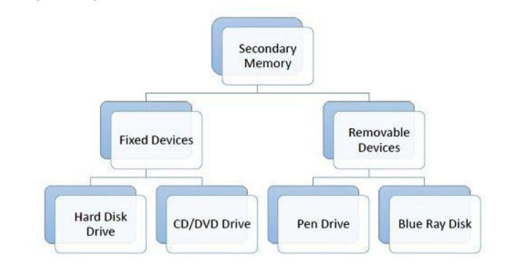
Classification of Secondary Memory
Blu Ray Disk (BD) is an optical storage media used to store high definition (HD) video and other multimedia filed. BD uses shorter wavelength laser as compared to CD/DVD. This enables writing arm to focus more tightly on the disk and hence pack in more data. BDs can store up to 128 GB data.

Slide 22
Any Queries??

