Slide 1
LUBRICANTS
Subject: Engg. Chemistry
Prepared by: Sushreeta Behera
Lecturer in chemistry
Govt. Polytechnic ,Bargarh

Slide 2
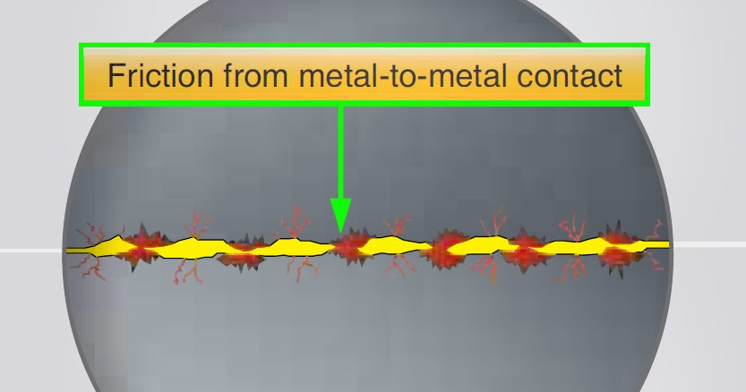
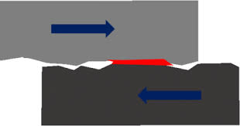
INTRODUCTION
In machine, the friction between metal to metal parts arises due to moving surfaces and machine experienced a resistance which retards their movement. Due to friction large amount of energy is liberated in the form of heat which reduces the efficiency of machine.

Slide 3
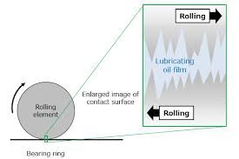
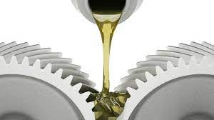
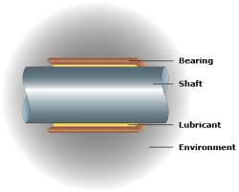
“Substances which apply between two moving and sliding surface to reduce friction between them are known as Lubricants” and the process by which friction between sliding surface is reduce, known as Lubrication.

Slide 4
FUNCTIONS OF LUBRICANTS
It reduces wear and tear of the surfaces by avoiding direct metal to metal contact between the rubbing surfaces, i.e. by introducing lubricants between the two surfaces
It reduces expansion of metal due to frictional heat and destruction of material
It acts as coolant of metal due to heat transfer media
It avoids unsmooth relative motion
It reduces maintenance cost
It also reduces power loss in internal combustion engines
It act as a seal and minimizes the leakage of gases

Slide 5
Classification of lubricants

Slide 6
Liquid lubricants or lubricating oils
Animal and Vegetables oils: tallow oil, whale oil, castor oil, palm oil (commonly used for boundary lubrication)
Mineral or Petroleum oils : petroleum fractions
Blended oils: The addition of higher molecular weight compounds like oleic acid, stearic acid, palmetic acid, etc or vegetables oil like coconut oil, castor oil

Slide 7
Characteristic of lubricating oils
high boiling point
low freezing point
adequate viscosity for proper functioning in service
high resistance to oxidation and heat
non-corrosive properties
stability to decomposition at the operating temperatures.

Slide 8
The liquid lubricants are preferred
1.If the operating temperature is high
2.If the sealing arrangement is perfect to prevent the loss of oil
3.If the speed of the rollers is high

Slide 9
(i) Animal and Vegetables oils: Animal oils are extracted from the crude fat and vegetables oils such as cotton seed oil and caster oils. These oils possess good oiliness and hence they can stick on metal surfaces effectively even under elevated temperatures and heavy loads. But they suffer from the disadvantages that they are costly, undergo easy oxidation to give gummy products and hydrolyze easily on contact with moist air or water. Hence they are only rarely used these days for lubrication. But they are still used as blending agents in petroleum based lubricants to get improved oiliness.
(ii) Mineral or Petroleum oils: These are basically lower molecular weight hydrocarbons with about 12 to 50 carbon atoms. As they are cheap, available in abundance and stable under service conditions, hence they are widely used. But the oiliness of mineral oils is less, so the addition of higher molecular weight compounds like oleic acid and stearic acid increases the oiliness of mineral oil.
(iii) Blended oils: No single oil possesses all the properties required for a good lubricant and hence addition of proper additives is essential to make them perform well. Such additives added into lubricating oils are called blended oils.

Slide 10
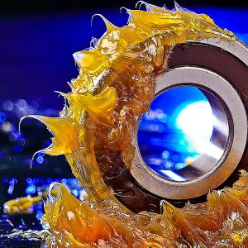
SEMISOLID LUBRICANTS
A semi-solid lubricant obtained by combining lubricating oil with thickening agents is termed as grease.
Lubricating oil is the principal component and it can be either petroleum oil or a synthetic hydrocarbon of low to high viscosity.
The thickeners consist primarily of special soaps of Li, Na, Ca, Ba, Al etc.

Slide 11
Classification
Soda based: In this case sodium soaps are used as a thickening agent in mineral or petroleum oil. They are slightly soluble in water. They can be used up to 175oC.
Lithium based: In this case lithium soaps are emulsifying with petroleum oil. Lithium soap grease is the most widely used multi-purpose grease, from general industrial uses to automobiles, bearings and home electric products. Usable in a wide range of temperature, and has excellent water resistance and mechanical stability.
Calcium based: In this case calcium soaps are emulsifying with petroleum oil. They are also water resistant and used up to 80oC. At higher temperature soap and petroleum oil are separate from each other.
Due to this poor heat resistance, it is used for general plain bearings operating under rather low speed and low load where temperature would not rise above 70°C in service.

Slide 12
Applications Suitable for Grease
Machinery that runs intermittently or is in storage for an extended period of time.
Machinery that is not easily accessible for frequent lubrication.
Grease can support much heavier load at lower speed
Used at lower temperature.
Grease functions as a sealant to minimize leakage and to keep out contaminants
grease to withstand the effects of water with no change in its ability to lubricate

Slide 13
Solid lubricants
Graphite, molybdenum disulphide (MoS2), boron nitride (BN)x are predominantly used as a solid lubricants.
These are used in powdered form or mixed with water or oil.
When used in water, it is known as aquadag and when it is used in oil, known as oildag.

Slide 14
They are preferred where
The operating conditions are such that a lubricating film cannot be secured by the use of lubricating oils or grease
Contamination (by the entry of dust particles) of lubricating oils or grease is unacceptable
The operating temperature or load is too high, even grease can not sustain.
Situations where combustible lubricants must be avoided.

Slide 15
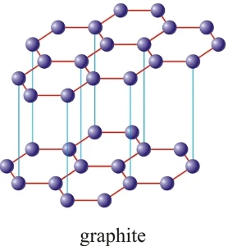
Graphite
It is most widely used as a solid lubricant.
Graphite has layer structure; layers are held together with the help of weak Vander Waals’ forces which facilitate the easy sliding of one layer on the other layer.
It is very soapy to touch, non-inflammable.
It is used at higher temperature (around 3750C) condition.
They are either used as powder form or mixed with oil or water.
Oil dag is used in internal combustion engines
Aqua dag is used in food industries.
It is also used in lathe machine workshops , railway track joints ,open gears , chains etc.

Slide 16
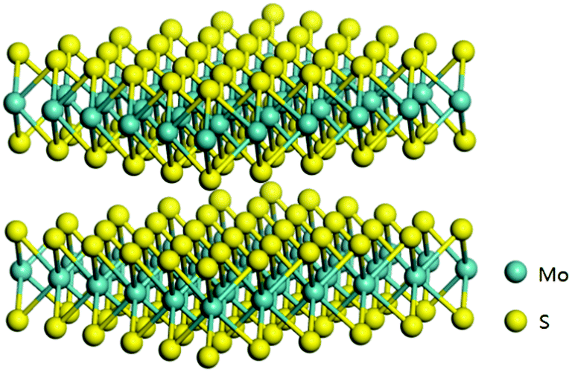
Molybdenum disulphide (MoS2):
It is sandwich like structure in which hexagonal layer of molybdenum (Mo) lies between two hexagonal layers of sulfur (S) atom like graphite each layers are held together with weak Vander Waals’ forces.
It is stable up to 400oC.
Molybdenum disulfide is used as a dry lubricant (powdered form) which is spread over the surfaces sliding at high velocities.
Used as a aquadag ,oildag or greases.

Slide 17
BORON NITRIDE
Hexagonal boron nitride (BN) has a graphite-like structure, but has been considered less effective than other solid lubricants except for high-temperature applications
It works upto 3300K.
It is not an electrical conductor and has no metallic lusture.
It is used as a anti wear additive in engine oil.

Slide 18
Properties of Lubricants
Cloud Point: The temperature at which lubricating oil becomes cloudy in appearance is called cloud point.
Pour Point: The lowest temperature at which the lubricant oil become semi-solid and ceases to flow is called pour point. It indicates the suitability of lubricants used in cold condition. Good lubricant should possess low pour point
Flash point: The flash point of a volatile material is the lowest temperature at which vapors of the material will ignite for a moment when an ignition source brought near to it.
Fire point: The fire point of a fuel is the lowest temperature at which the vapour of that fuel will continue to burn for at least 5 seconds when an ignition source brought near to it.

Slide 19
Viscosity: Viscosity is the property of a fluid that determines its resistance to flow. It is an indicator of flow ability of lubricating oil . A good lubricating oil is that whose viscosity does not change with temperature.
Viscosity Index: The variation of viscosity of a liquid with temperature is called viscosity index. A relatively small change in viscosity with temperature is indicated by high viscosity index whereas, a low viscosity index shows, a relatively large change in viscosity with temperature.

Slide 20
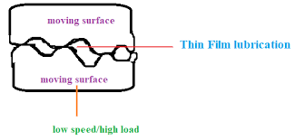
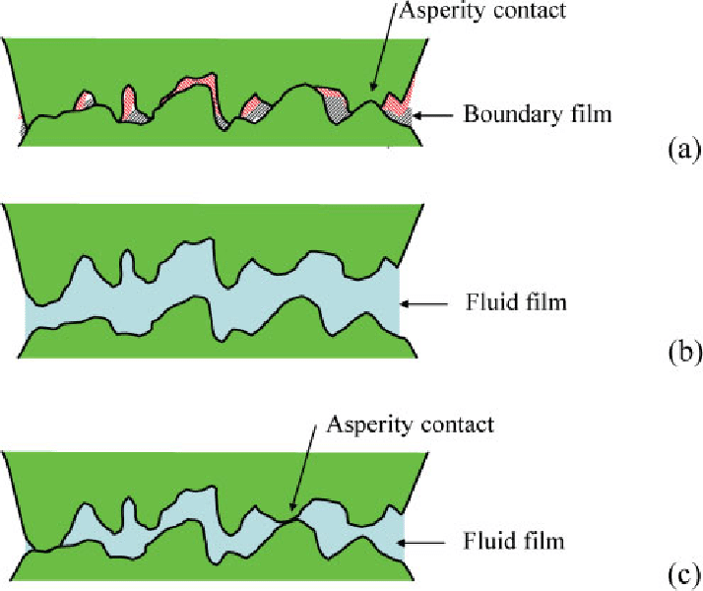
Mechanism of Lubrication

Slide 21
CORROSION
subject: engg. chemistry
prepared by: Sushreeta behera
lecturer in chemistry
Govt. Polytechnic ,bargarh

Slide 22
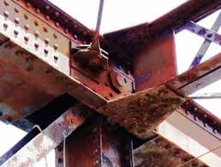
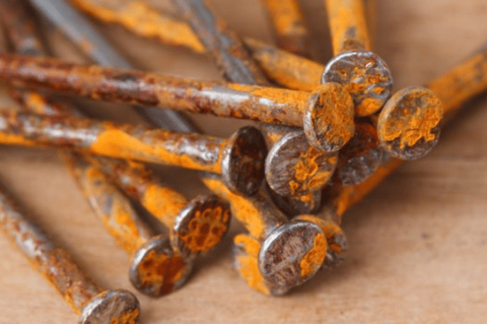
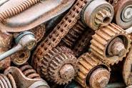
INTRODUCTION
Corrosion is a natural process that converts a refined metal into a more chemically-stable form such as oxide, hydroxide, or sulphide.
The process of conversion of a metal into an undesirable compound on exposure to atmospheric conditions i.e., moisture (water) and air is called corrosion. It is also called weeping of metals.

Slide 23
TYPES OF CORROSION
Types of Corrosion: -
Corrosion is of the following types:
i. Atmospheric corrosion
ii. Water line corrosion

Slide 24
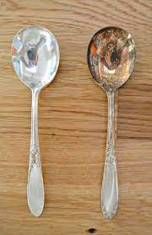
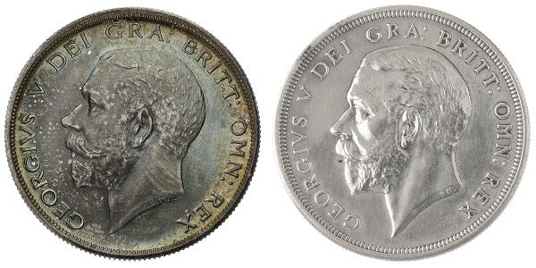
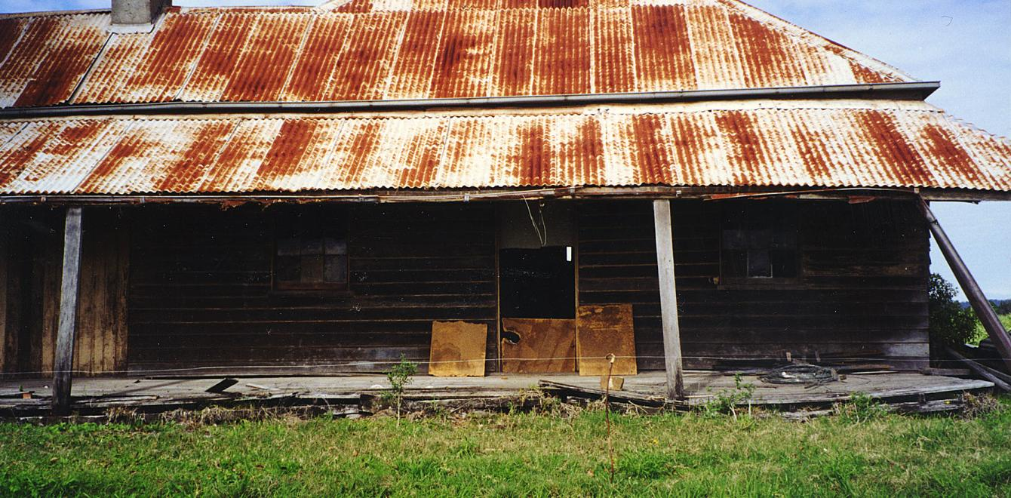
Atmospheric corrosion
The process of development of undesirable substances usually oxide over the surface of a metal when exposed to atmosphere is called atmospheric corrosion.
METAL+ OXYGEN METAL OXIDE
Example: (a) rusting of iron,
(b) tarnishing of silver,
(c) developing of green coating over copper and bronze.

Slide 25
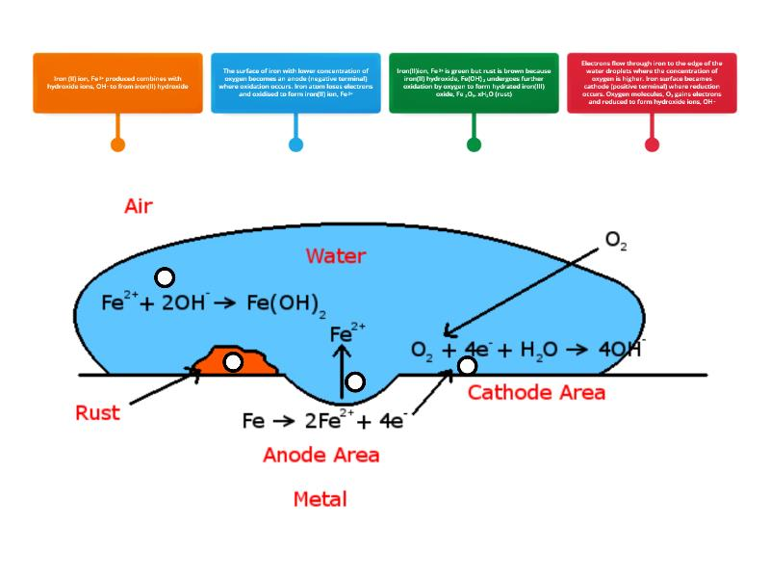
Mechanism of rusting of iron

Slide 26
Pure iron does not rust. However commercial form of iron behaves like a tiny electric cell in presence of water containing dissolved oxygen and acidic substances like CO2, SO2, etc.
The following changes stake place on the surface of iron during the process of corrosion .
At Anode: At anode iron gets oxidized in to ferrous ion. 2Fe → 2Fe2+ + 4e–
The electrons thus formed migrate towards the cathodic part of the piece of iron.
At Cathode: At the cathodic part, the electrons combine with moisture and dissolved oxygen to form hydroxyl ions. H2O + O + 2e– → 2OH
The Fe2+ ions and OH – ions then diffuse under the influence of dissolved oxygen and Fe2+ ions are oxidized into Fe3+ ions.
These ferric ions then combine with OH – ions to form hydrated ferric oxide which is nothing but rust.
2Fe2+ + H2O + O → 2Fe3+ + 2OH –
2Fe3+ + 6OH – → Fe2O3.3H2O (Rust)

Slide 27
WATERLINE CORROSION
This type of corrosion occurs due to differential oxygen concentration above and below the level of water.
When water is stored in a steel tank, it is noticed that corrosion occurs along the line just below the level of water.
The concentration of oxygen in the area above the water line is high and hence the area is called cathodic part. The area just below the water line is called anodic part as this part is deficient in oxygen. This type of corrosion is mostly seen in ships, water tanks, etc.

Slide 30
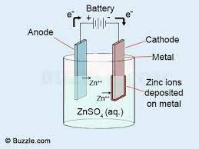
PROTECTION OF CORROSION
Alloying: Corrosion can be prevented by alloying a metal. Alloying prevent corrosion in two ways.
i. Homogeneity
ii. Oxide film
2. Galvanization: The process of applying a coating of zinc over iron with a view to protect it from rusting is called Galvanization

Slide 31
CHEMICALS IN AGRICULTURE
Subject: Engg. Chemistry
Prepared by: Sushreeta Behera
Lecturer in chemistry
Govt. Polytechnic ,Bargarh

Slide 32
Pesticides: Pesticides are chemical compounds that are used to kill pests, including insects, rodents, fungi, and unwanted plants (weeds).
The term pesticide includes all the following:
i. Insecticides
ii. Herbicides
iii. Fungicides.

Slide 33
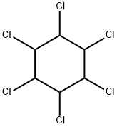
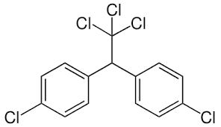
Insecticides: Insecticides are substances used to kill insects.
Examples: - Chlorinated hydrocarbons like DDT, BHC (gammaxene), Aldrin, Dieldrin etc.
DDT-dichloro-diphenyl-trichloroethane BHC- Benzene Hexachloride.

Slide 34
Advantages of Insecticides
Insecticides can increase yields, improving production & income
Insecticides improve the quality of crops
Insecticides can provide quick pest control
Insecticides can provide protection against multiple pest species

Slide 35
Herbicides: A herbicide is a chemical substance used to kill unwanted plants. These are commonly known as weedkillers.
Examples: Arsenic acid, dinitrophenol, dipyridyl, carbamate, Propanil, Paraquat, etc.
Uses-
1.Herbicides can be used to clear waste ground, industrial and construction sites, railways, and railway embankments as they kill all plant material with which they come into contact. 2. Also, these are applied in ponds and lakes to control algae & plants such as water grasses that can interfere with activities like swimming and fishing.

Slide 36
Fungicides:
Fungicides are pesticides that prevent, kill, mitigate, or inhibit the growth of fungi on plants.
Ex- Bleaching powder, CuSO4 solution, aluminium phosphide, Copper oxychloride, Carbendazim, Carboxin, Mancozeb, etc.
Uses-
These are used to control fungi that damage plants.

Slide 37
Bio-fertilizers
Biofertilizers are the substance that contains living microorganism. Biofertilizers increase
the nutrients of host plants when applied to their seeds, plant surface or soil by colonizing the rhizosphere of the plant. These are environment friendly substitute for harmful chemical fertilizers.
The microorganism in Biofertilizers restore the soil’s natural nutrient cycle and build soil organic matter.
These are extremely advantageous in enriching soil fertility & fulfilling plant nutrient requirements.
Ex-Rhizobium, Azotobacter, Azospirillum, Blue green algae etc.
Uses:
i. Rhizobium inoculant is used for leguminous crops.
ii. Azotobacter can be used with crops like wheat, maize. mustard etc.
iii. Blue green algae is used for paddy crops.
iv. Azospirillum is used for maize, sugarcane, millets etc.

Slide 38
Apparatus used in chemistry laboratory
subject: engg. chemistry practical
prepared by: Sushreeta behera
lecturer in chemistry
Govt. Polytechnic ,bargarh

Slide 45
Woulf bottle
A Woulf bottle is used during chemical analysis to pass gases through a liquid and is named after Peter Woulfe.

Slide 46
Thistle funnel
A thistle tube is a piece of laboratory glassware consisting of a shaft of tube, with a reservoir and funnel-like section at the top. Thistle funnels are used to add small volumes of liquids to an exact position.

Slide 48
Reagent bottle
Reagent bottles, also known graduated bottles, are containers made of glass, plastic, borosilicate or related substances, and topped by special caps or stoppers. They are intended to contain chemicals in liquid or powder form for laboratories and stored in cabinets or on shelves

Slide 49
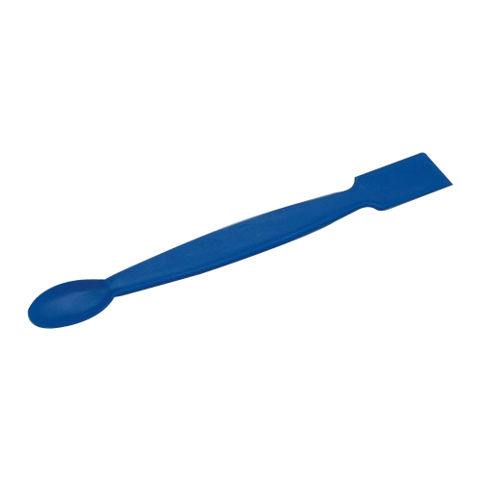
SPATULA
Laboratory spatulas are used to transferring materials and samples from one place to another. Reusable spatulas are typically made of stainless steel, which is resistant to heat and cold, acids, bases, solvents, and other chemicals.

Slide 50
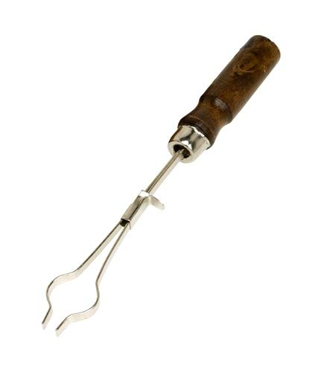

Slide 57
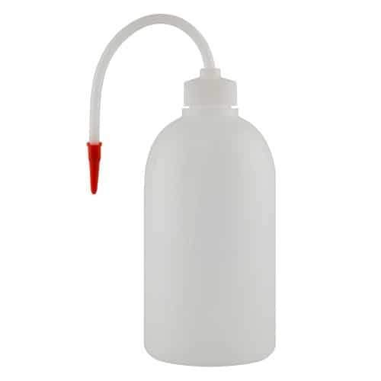
Wash bottle
A wash bottle is a squeeze bottle with a nozzle, used to rinse various pieces of laboratory glassware, such as test tubes and round bottom flasks.

Slide 59
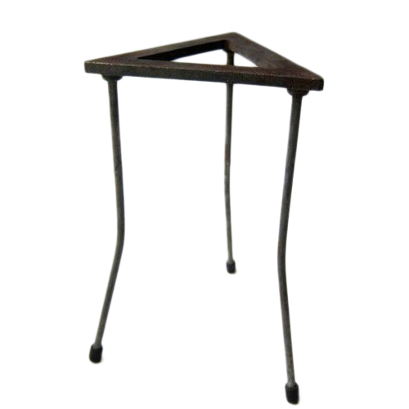
Tripod stand
A laboratory tripod is a three-legged platform used to support flasks and beakers. Tripods are usually made of stainless steel or aluminium and lightly built for portability within the lab. Often a wire gauze is placed on top of the tripod to provide a flat base for glassware.

Slide 60
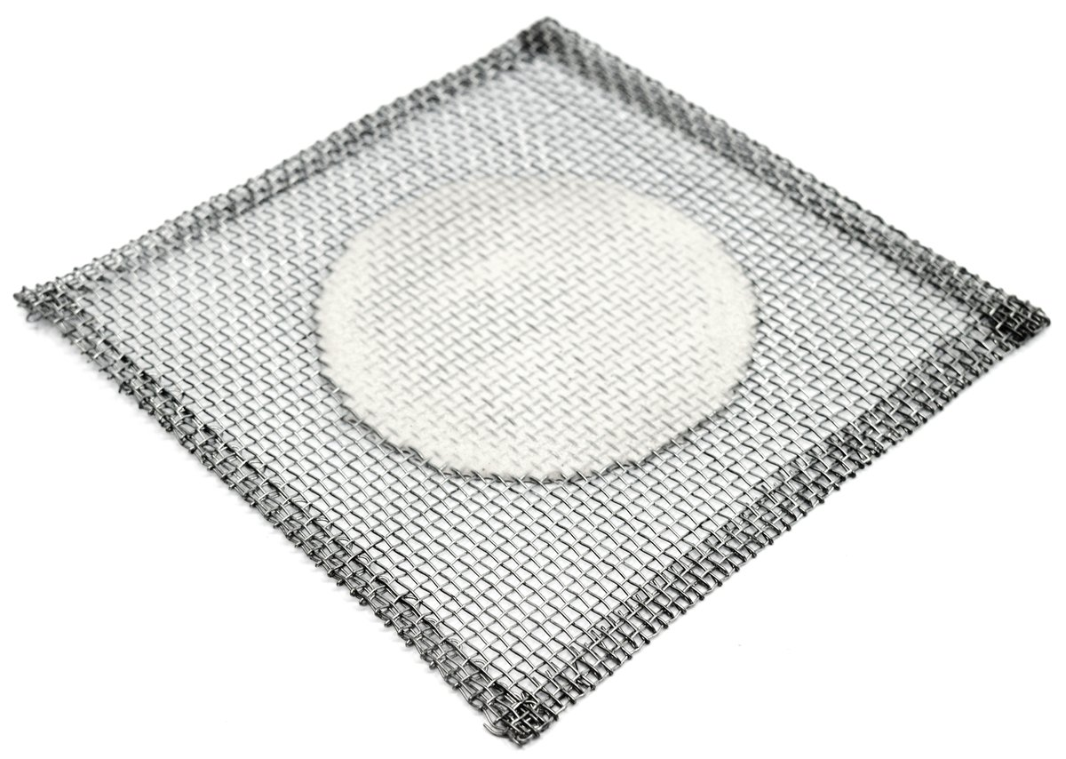
Wire gauze
A wire gauze is a sheet of thin metal that has net-like patterns or a wire mesh. Wire gauze is placed on the support ring that is attached to the retort stand between the Bunsen burner and the glassware to support the beakers, flasks, or other glassware during heating.

Slide 64
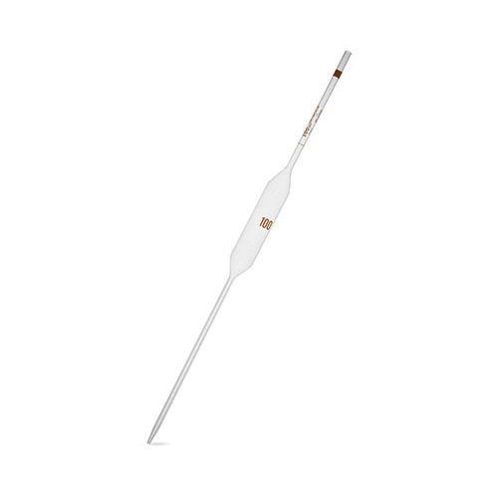
Pipette
a narrow tube used in a laboratory for measuring or moving small amounts of liquids

